Slide 1

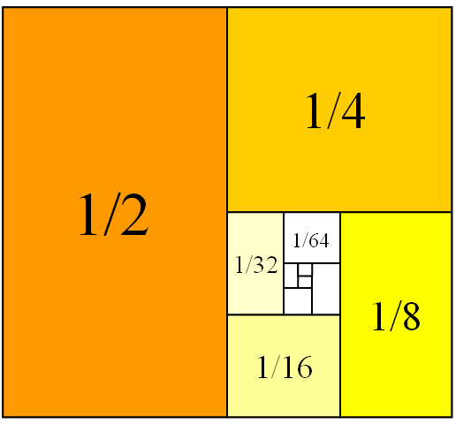
Mathematics for Engineering: Calculus
Chapter 4: APPLICATIONS OF DERIVATIVES
Department of Mathematics, FPT University

Slide 2
Contents
4.1. Related Rates
4.2. Linear Approximations and Differentials
4.3. Maxima and minima
4.4. The Mean value theorem
4.5. Derivates and the shapes of Graphs
4.6. Limits at Infinity and Assymtotes
4.7. Applied Optimization Problems
4.9. Newton’s Method
4.10. Antiderivatives

Slide 3
APPLICATIONS OF DIFFERENTIATION
4.1
Related Rates
In this section, we will learn:
How to compute the rate of change of one quantity
in terms of that of another quantity.

Slide 4
RELATED RATES
Example 1
Air is being pumped into a spherical balloon so that its volume increases at a rate of
100 cm³/s.
How fast is the radius of the balloon increasing when the diameter is 50 cm?
Notes:
List quantities: V, r, t
V in terms of r and t
r in terms of t.

Slide 5
Example 1
The key thing to remember is that rates of change are derivatives.
  In this problem, the volume and the radius are
  both functions of the time t.
  The rate of increase of the volume with respect
  to time is the derivative dV / dt.
  The rate of increase of the radius is dr / dt.

Slide 6
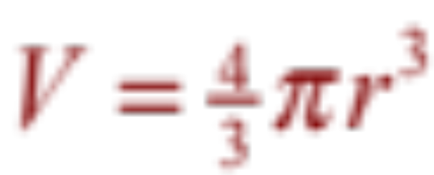
RELATED RATES
Example 1
To connect dV/dt and dr/dt, first
we relate V and r by the formula for
the volume of a sphere:

Slide 7
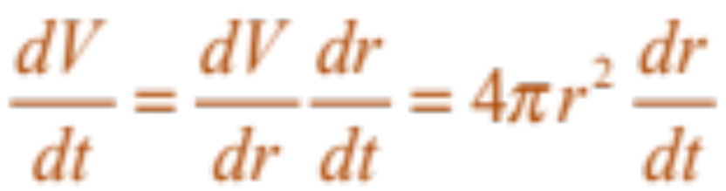
Example 1
To use the given information, we differentiate each side of the equation with respect to t.
  To differentiate the right side, we need to use
  the Chain Rule:

Slide 8
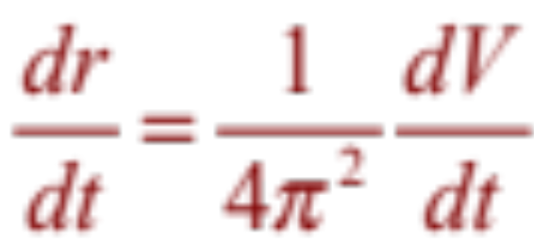
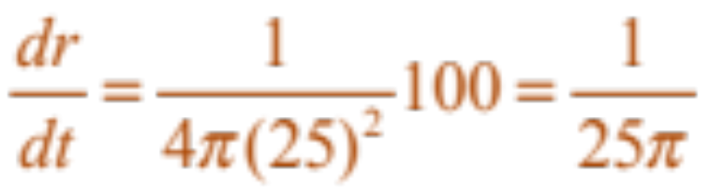
RELATED RATES
Example 1
Now, we solve for the unknown quantity:
  If we put r = 25 and dV / dt = 100 in this equation,
  we obtain:
  The radius of the balloon is increasing at the rate of 1/(25π) ≈ 0.0127 cm/s.

Slide 9
Example 2
A ladder 10 ft long rests against a vertical wall.
If the bottom of the ladder slides away
from the wall at a rate of 1 ft/s, how fast is
the top of the ladder sliding down the wall when the bottom of the ladder is 6 ft from
the wall?

Slide 10
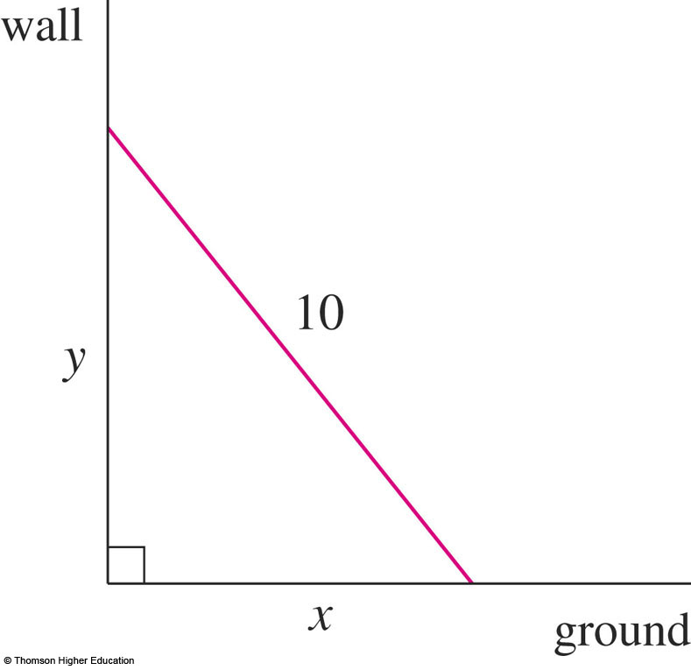
Example 2
We first draw a diagram and label it
as in the figure.
  Let x feet be the distance from the bottom of the ladder to the wall and y feet the distance from the top of the ladder to the ground.
  Note that x and y are
  both functions of t
  (time, measured in
  seconds).

Slide 11
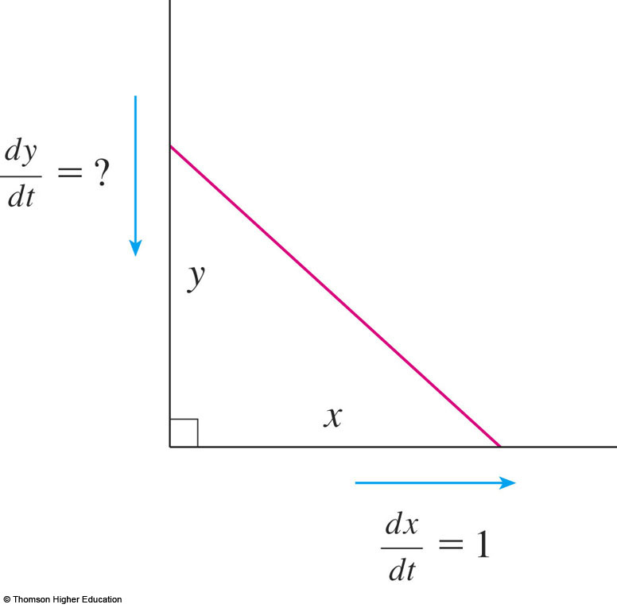
Example 2
We are given that dx / dt = 1 ft/s
and we are asked to find dy / dt
when x = 6 ft.

Slide 12
Example 2
In this problem, the relationship between
x and y is given by the Pythagorean Theorem: x² + y² = 100

Slide 13
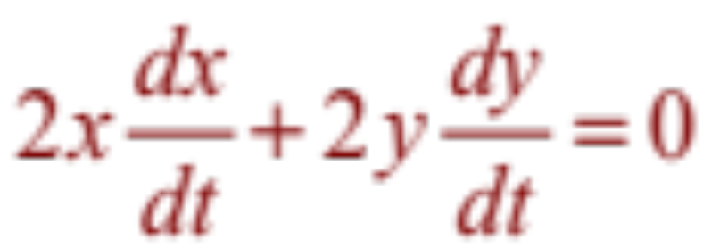
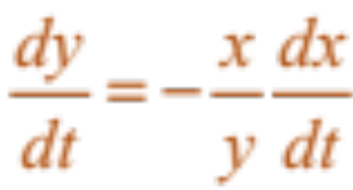
Example 2
Differentiating each side with respect to t using the Chain Rule, we have:
  Solving this equation for the desired rate,
  we obtain:

Slide 14
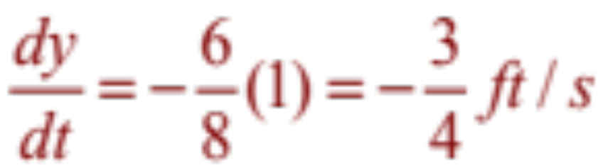
Example 2
When x = 6 , the Pythagorean Theorem gives y = 8 and so, substituting these values and
dx / dt = 1, we have:
  The fact that dy / dt is negative means that
  the distance from the top of the ladder to
  the ground is decreasing at a rate of ¾ ft/s.
  That is, the top of the ladder is sliding down
  the wall at a rate of ¾ ft/s.

Slide 15
APPLICATIONS OF DIFFERENTIATION
4.2
Linear Approximations
and Differentials
In this section, we will learn about:
Linear approximations and differentials
and their applications.
Notes:
The general equation of a line tangent to the graph of a function, and its use in approximating that function near a point.
The differential as the difference between the linearization of a function and that function.

Slide 16
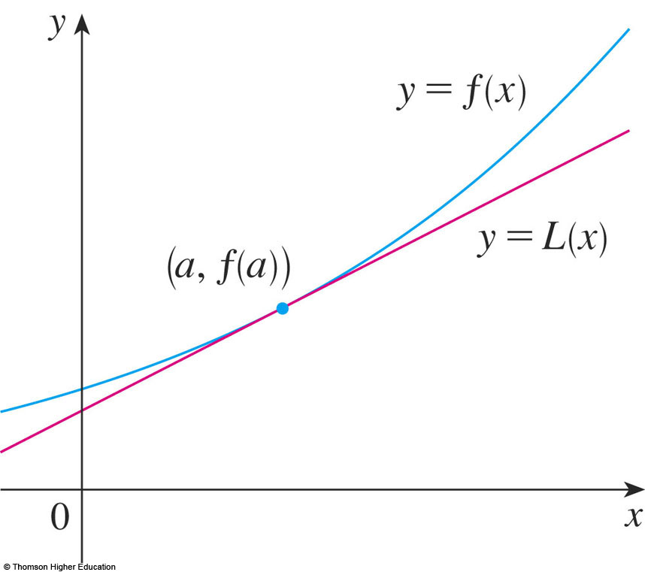
LINEAR APPROXIMATIONS
We use the tangent line at (a, f(a)) as an approximation to the curve y = f(x) when x is near a.
  An equation of
  this tangent line is
  L(x) = y = f(a) + f’(a)(x - a)

Slide 17
LINEAR APPROXIMATION
Equation 1
The approximation
f(x) ≈ f(a) + f’(a)(x – a) = L(x)
is called the linear approximation of f at a.

Slide 18
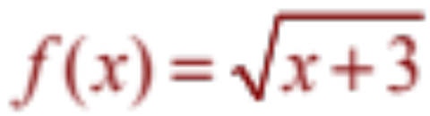
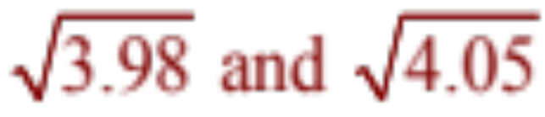
LINEAR APPROXIMATIONS
Example 1
Find the linearization of the function
at a = 1 and use it to approximate the numbers
Are these approximations overestimates or underestimates?
Notes:
select the appropriate function, in this case such that f(x) = x^{1/2}

Slide 19
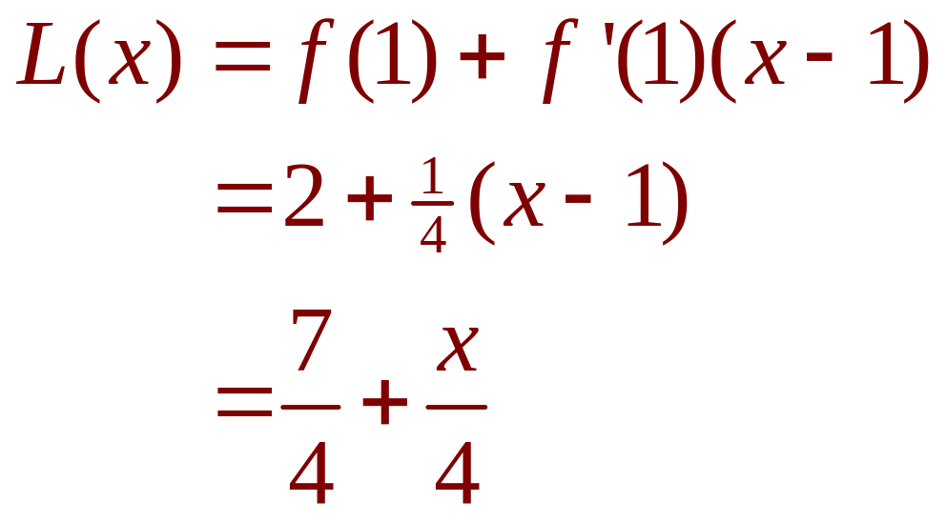
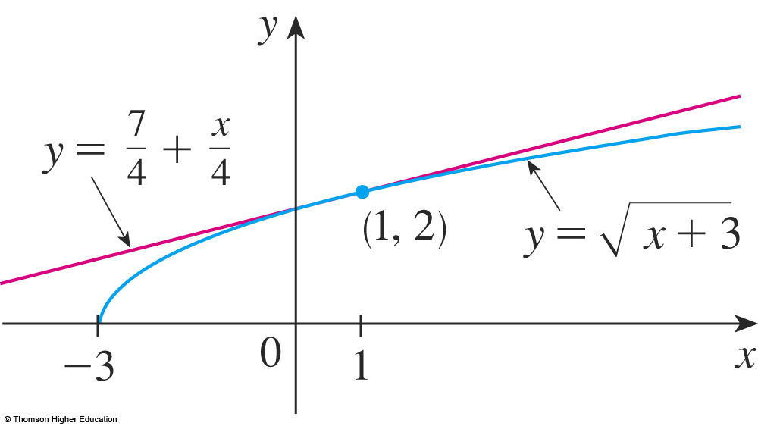
LINEAR APPROXIMATIONS
Example 1
Putting these values into Equation 2, we see that the linearization is:

Slide 20
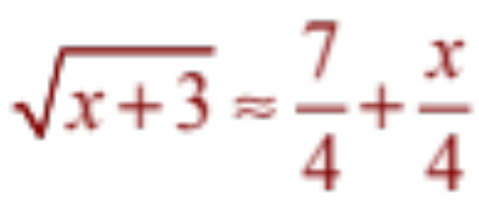
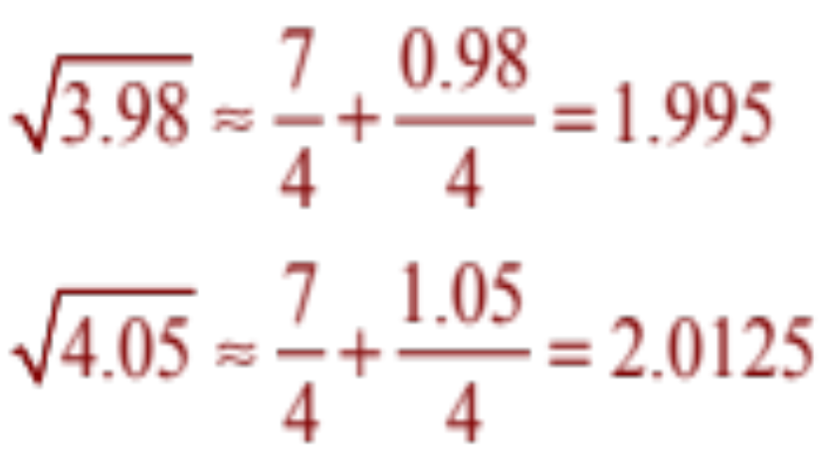
LINEAR APPROXIMATIONS
Example 1
The corresponding linear approximation is:
(when x is near 1)
In particular, we have:

Slide 21
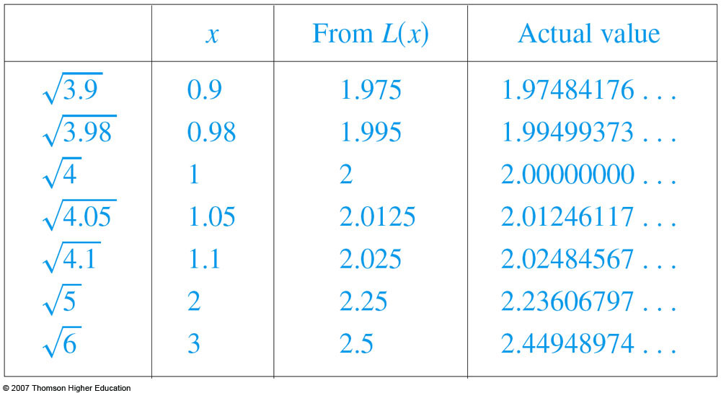
LINEAR APPROXIMATIONS
Look at the table and the figure.
  The tangent line
  approximation
  gives good
  estimates if x
  is close to 1.
  However,
  the accuracy decreases
  when x is farther away from 1.

Slide 22
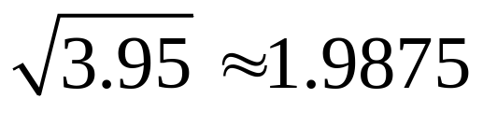
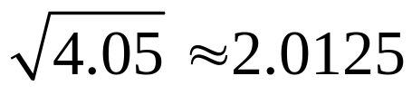
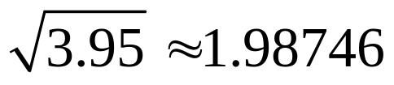
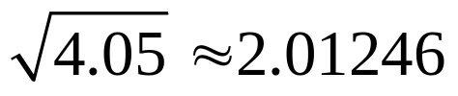
Use the linear approximation to of the function at
a=3 to approximate the numbers. Select the correct ones.
a) b)
c) d)

Slide 23
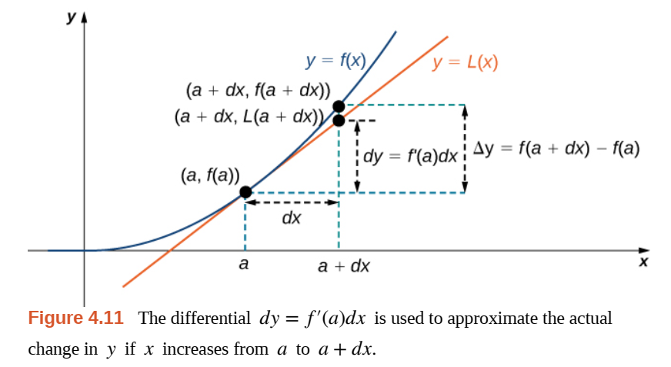
DIFFERENTIALS
Example 2
Notes:
Differential of y=f(x) is dy = f’(x)dx

Slide 24

DIFFERENTIALS
Example 1
Example:
Notes:
Differential of y=f(x) is dy = f’(x)dx

Slide 25
DIFFERENTIALS
Example 1:
Notes:
Differential of y=f(x) is dy = f’(x)dx

Slide 26
DIFFERENTIALS
Example 2
The radius of a sphere was measured
and found to be 21 cm with a possible error
in measurement of at most 0.05 cm.
What is the maximum error in using this
value of the radius to compute the volume
of the sphere?
Notes:
Differential of y=f(x) is dy = f’(x)dx

Slide 27
DIFFERENTIALS
Example 2
If the radius of the sphere is r, then
its volume is V = 4/3πr³.
  If the error in the measured value of r
  is denoted by dr = ∆r, then the corresponding
  error in the calculated value of V is ∆V~dV.

Slide 28
DIFFERENTIALS
Example 2
This can be approximated by the differential
dV = 4πr²dr
When r = 21 and dr = 0.05, this becomes:
dV = 4π(21)² 0.05 ≈ 277
  The maximum error in the calculated volume is about 277 cm³.

Slide 29
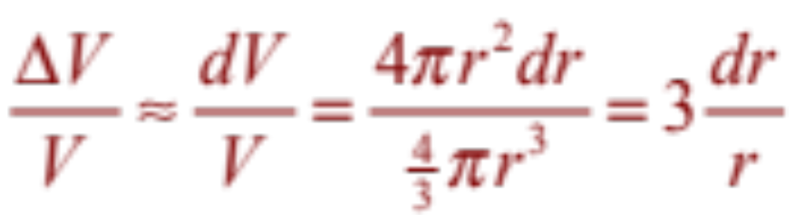
RELATIVE ERROR
Note
Relative error is computed by dividing
the error by the total volume:
  Thus, the relative error in the volume is about
  three times the relative error in the radius.

Slide 30
RELATIVE ERROR
Note
In the example, the relative error in the radius
is approximately dr/r = 0.05/21 ≈ 0.0024
and it produces a relative error of about 0.007 in the volume.
  The errors could also be expressed as
  percentage errors of 0.24% in the radius
  and 0.7% in the volume.

Slide 31
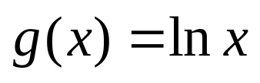
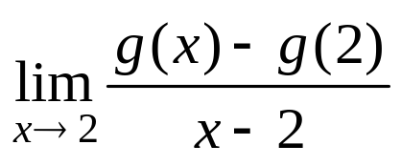
Quiz
Find the limit if
.
a. 1 b. ½ c. 1/3 d. 2
Notes:
This is (lnx)’

Slide 32

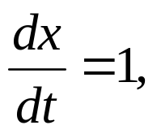

Quiz
Find when x=2 if
a. 1 b.2 c.3 d.4 e.0
Notes:
Chain rule

Slide 33
Quiz
The equation of the tangent line to the curve y= x - sin x at (∏, ∏)
is
y=0 b) y=2x c) y=2x-2
d) y=2x+2 e) None of the others

Slide 34
Quizzes
If 1/f =1/u+1/v then du/dv is:
f/(v-f)² b) –f²/(v-f)²
c) 2f²/(v-f)² d)-2f²/(v-f)²
e) None of the others

Slide 35
APPLICATIONS OF DIFFERENTIATION
4.3
Maxima and Minima
In this section, we will learn:
How to find the maximum
and minimum values of a function.
Notes:
Intuitive and precise definitions of local and absolute extreme.
The extreme value theorem.
Critical numbers, Fermat’s theorem and the closed interval method.

Slide 36
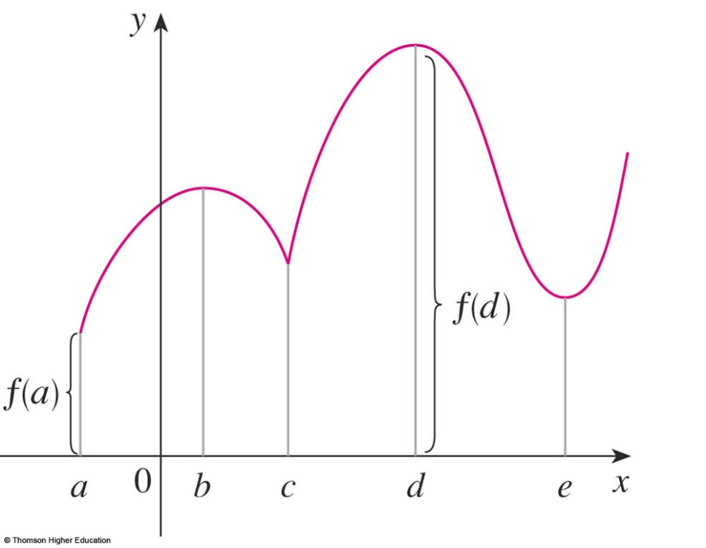
MAXIMUM & MINIMUM VALUES
Definition 1
A function f has an absolute maximum (or global maximum) at c if f(c) ≥ f(x) for all x in D, where D is the domain of f.
The number f(c) is called
the maximum value of f
on D.

Slide 37
MAXIMUM & MINIMUM VALUES
Definition 1
Similarly, f has an absolute minimum at c
if f(c) ≤ f(x) for all x in D and the number f(c)
is called the minimum value of f on D.
The maximum and minimum
values of f are called
the extreme values of f.

Slide 38
MAXIMUM & MINIMUM VALUES
Definition 2
  A function f has a local maximum (or relative maximum) at c if f(c) ≥ f(x) when x is near c.
  Similarly, f has a local minimum at c
  if f(c) ≤ f(x) when x is near c.

Slide 39
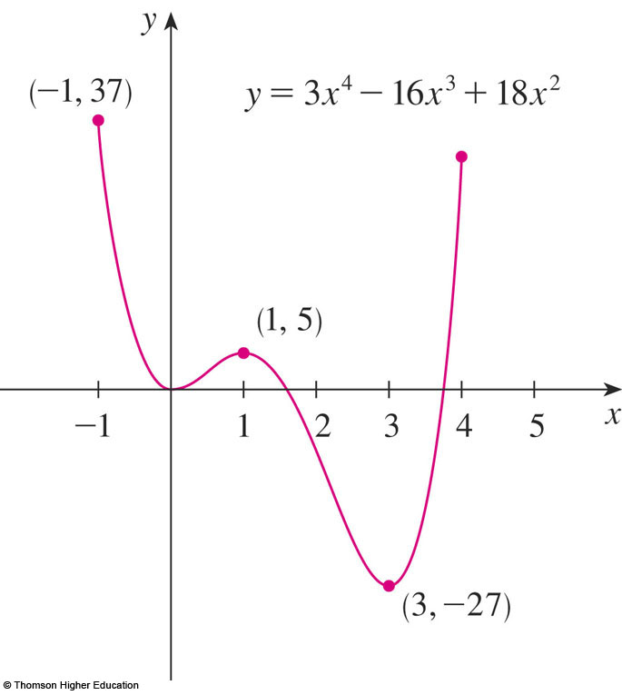
MAXIMUM & MINIMUM VALUES
Example
The graph of the function
f(x) = 3x⁴ – 16x³ + 18x², -1 ≤ x ≤ 4
is shown here.
f(1) = 5 is a local maximum
the absolute maximum is f(-1) = 37
f(0) = 0 is a local minimum and
f(3) = -27 is both a local
and an absolute minimum.

Slide 40
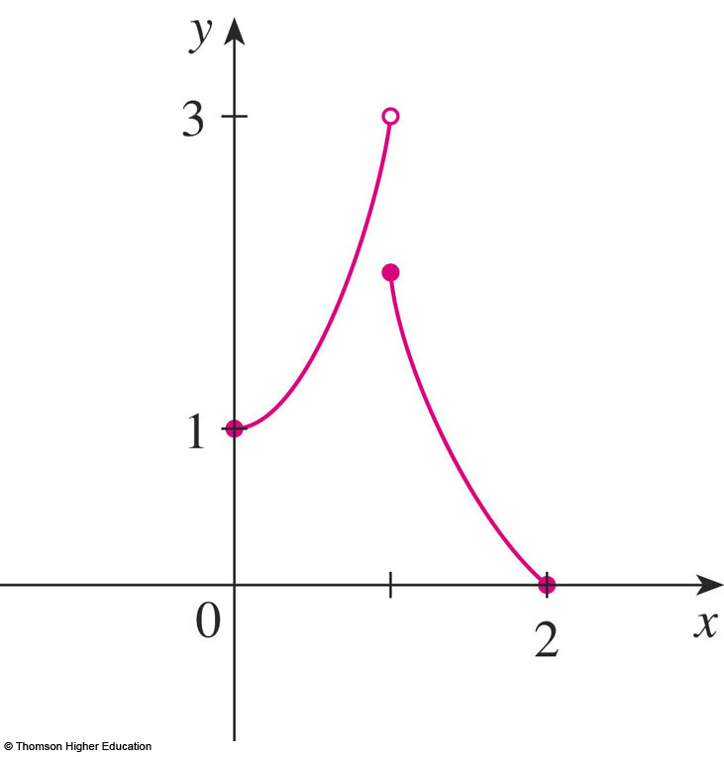
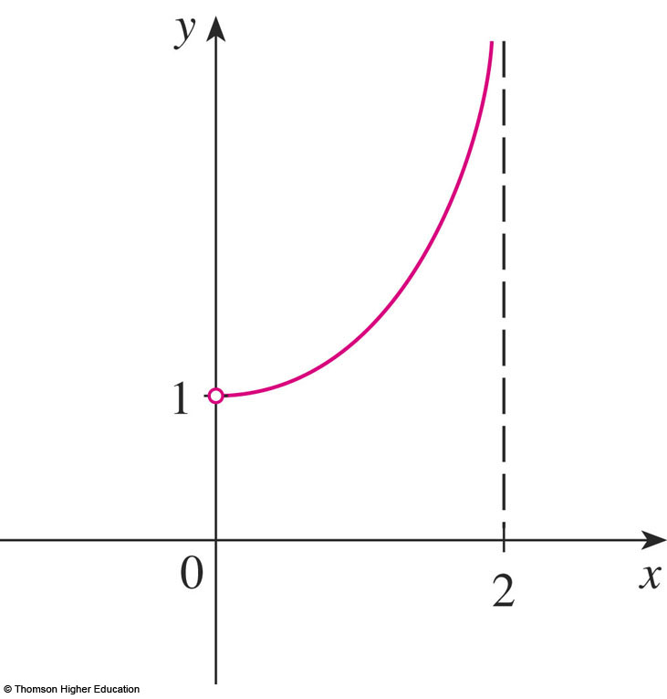
EXTREME VALUE THEOREM
In the first figure, why isn’t 3 the absolute maximum value?
In the second, does it have the absolute maximum and minimum value?

Slide 41
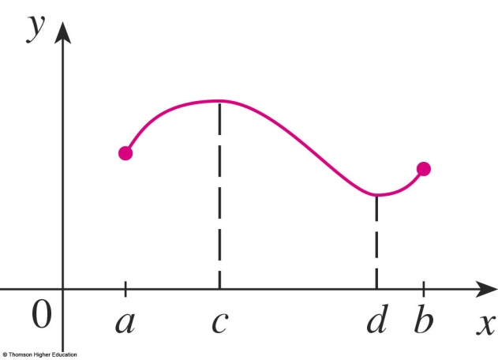
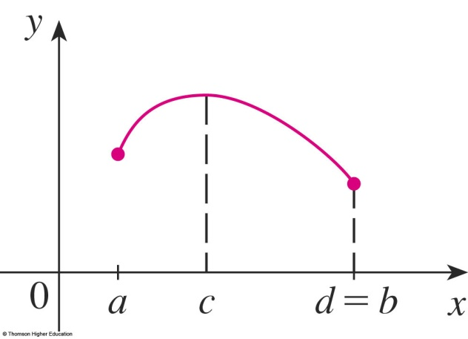
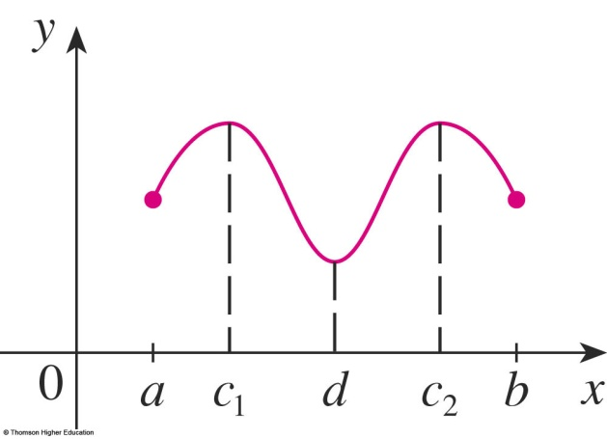
EXTREME VALUE THEOREM
Theorem
If f is continuous on a closed interval [a, b],
then f attains an absolute maximum value f(c)
and an absolute minimum value f(d)
at some numbers c and d in [a, b].

Slide 42
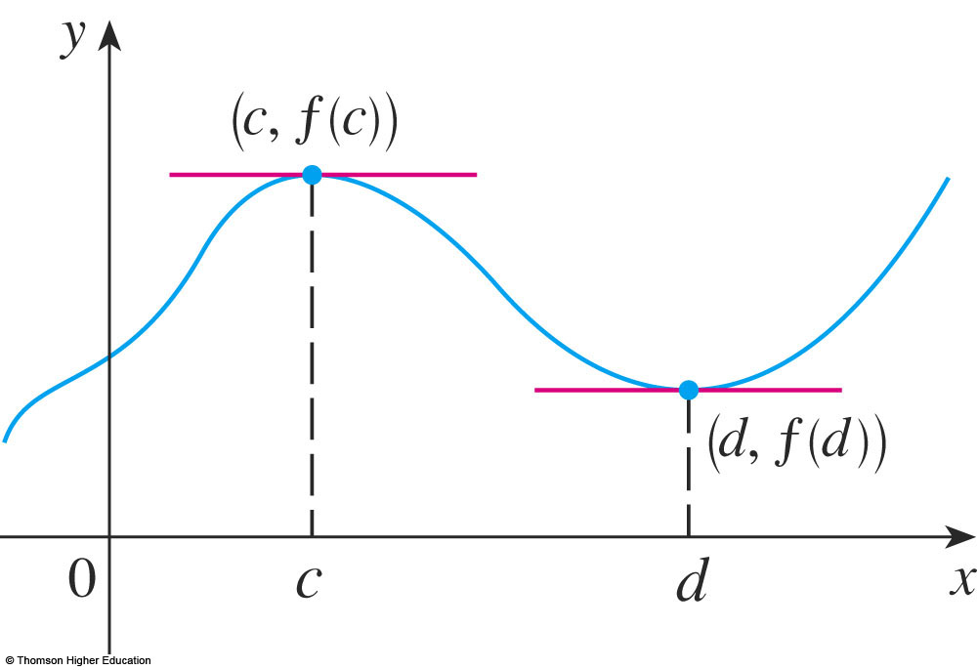
THE FERMAT’S THEOREM
  We start by looking for local extreme values.

Slide 43
FERMAT’S THEOREM
If f has a local maximum or minimum at c, and
if f ’(c) exists, then f ’(c) = 0.

Slide 44
Is it true if say that
” f’(c)=0 if f has local extreme value at c?”
Answer: It is false, see next

Slide 45
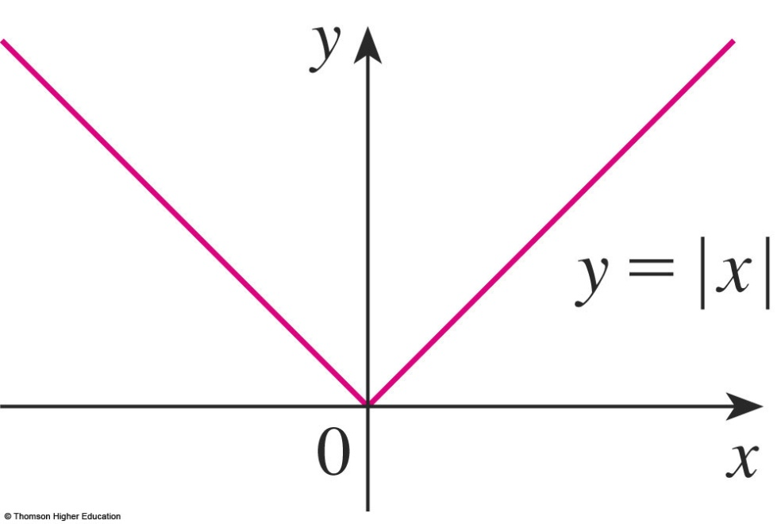
CRITICAL NUMBERS
Example
  The function f(x) = |x| has its (local and absolute) minimum value at 0.
  f ’(0) does not exist.

Slide 46
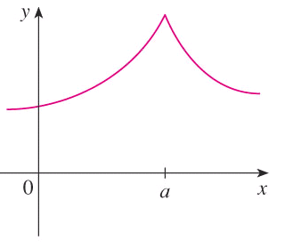

CRITICAL NUMBERS
Definition
A critical number (giá trị tới hạn) of a function f is a number c in the domain of f
such that either f ’(c) = 0 or f ’(c) does not exist.

Slide 47
CRITICAL NUMBERS
Theorem
If f has a local maximum or minimum at c,
then c is a critical number of f.

Slide 48
CLOSED INTERVAL METHOD
To find the absolute maximum and minimum values of a continuous function f on a closed interval [a, b]:
  Find the values of f at the critical numbers of f
  in (a, b).
  Find the values of f at the endpoints of the interval.
  The largest value from 1 and 2 is the absolute maximum value. The smallest is the absolute minimum value.
Notes:
Example: find absolute extreme for the function f(x) = (x-2)/ (x² +1) on the interval.

Slide 49
Select the correct ones.
If f’(c)=0 then f has the local maximum or minimum at c.
If f has the absolute minimum value at c then f’(c)=0.
If f is continuous on (a,b) then f attains an absolute maximum value
f(c) and an absolute minimum value f(d) for some c and d in (a,b).
d. All of the above.
e. None of the above.

Slide 50
APPLICATIONS OF DIFFERENTIATION
4.4
The Mean Value Theorem
In this section, we will learn about:
The significance of the mean value theorem.
Notes:
Rolle’s theorem – what it says and when it is applicable.
The mean value theorem – what it says and when it is applicable.
How to obtain information about a function from its derivative.

Slide 51
ROLLE’S THEOREM
Let f be a function that satisfies the following three hypotheses:
  f is continuous on the closed interval [a, b]
  f is differentiable on the open interval (a, b)
  f(a) = f(b)
Then, there is a number c in (a, b) such that f’(c) = 0.

Slide 52
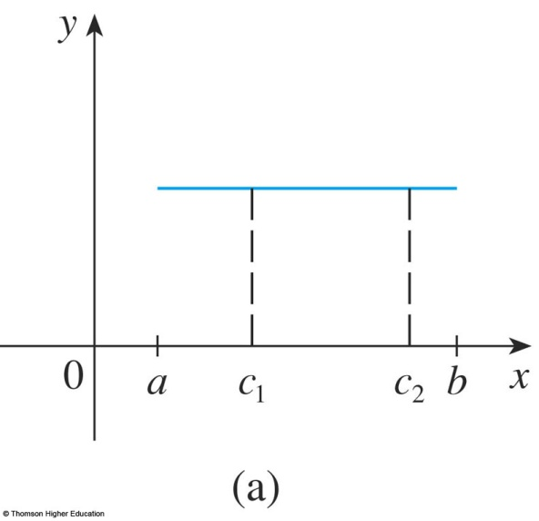
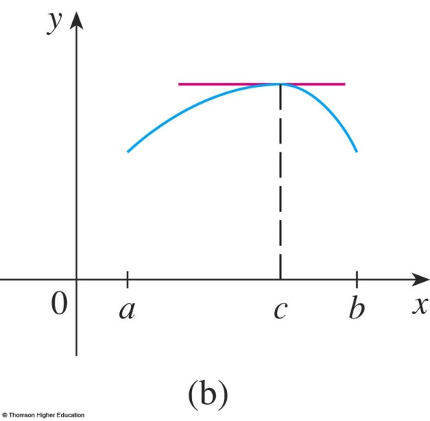
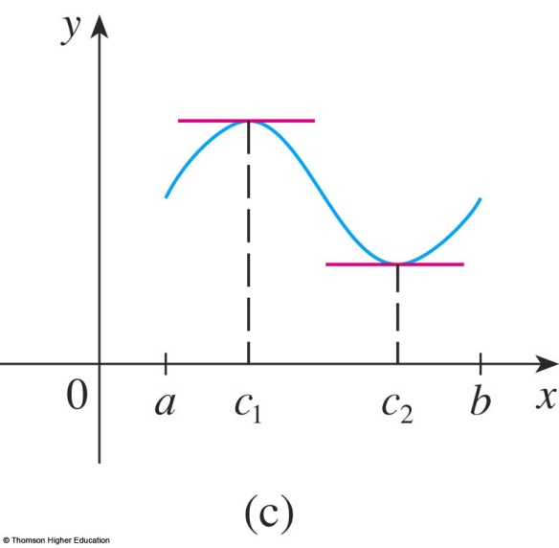
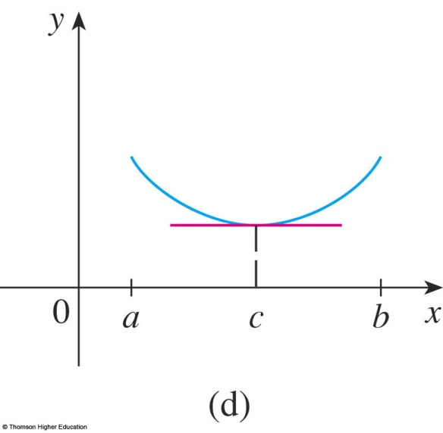
ROLLE’S THEOREM
The figures show
the graphs of
four such functions.

Slide 53
Let f(x)=x³-2x²+x-5. Find the numbers c in the Rolle’s theorem?
Answer: f’(c)=0 iff c=1 or c= 1/3

Slide 54
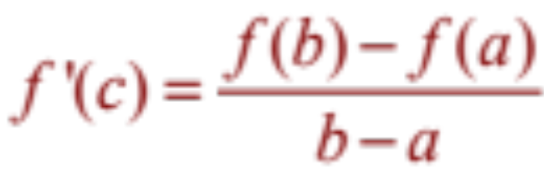
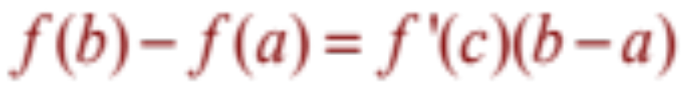
MEAN VALUE THEOREM
Let f be a function that fulfills two hypotheses:
  f is continuous on the closed interval [a, b].
  f is differentiable on the open interval (a, b).
Then, there is a number c in (a, b) such that
or, equivalently,

Slide 55
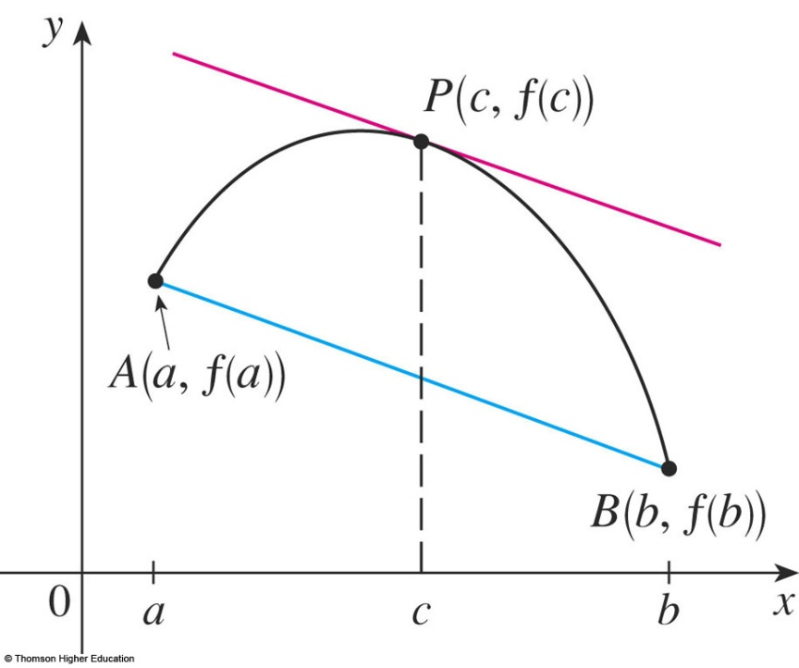
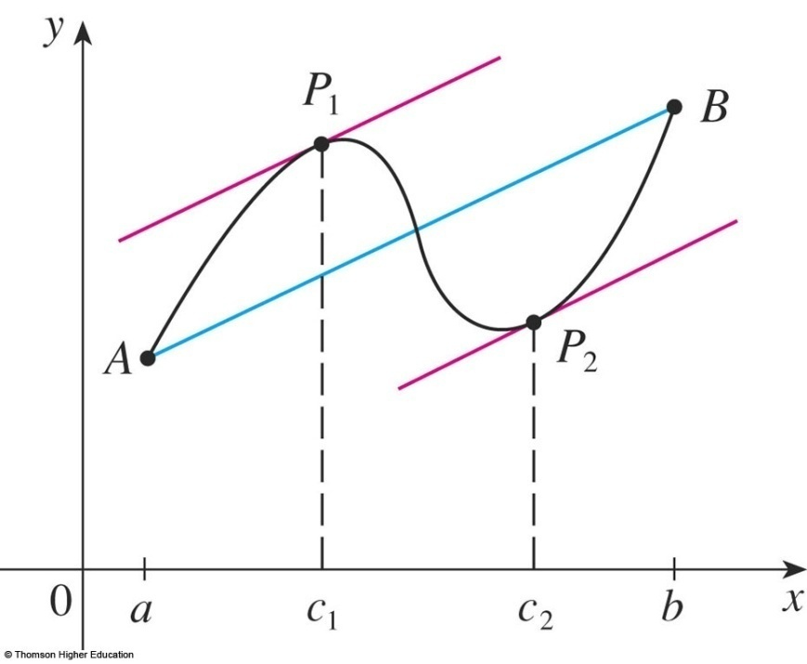
MEAN VALUE THEOREM
f ’(c) is the slope of the tangent line at (c, f(c)).
  There is at least one point P(c, f(c)) on the graph where the slope of the tangent line is the same as the slope of the secant line AB.

Slide 56
Example
Suppose that f(0) = -3 and f ’(x) ≤ 5 for all values of x.
  How large can f(2) possibly be?
We are given that f is differentiable - and therefore continuous - everywhere.
In particular, we can apply the Mean Value Theorem on the interval [0, 2].
  There exists a number c such that
  f(2) – f(0) = f ’(c)(2 – 0)
  So, f(2) = – 3 + 2 f ’(c)

Slide 57
Example
  We are given that f ’(x) ≤ 5 ∀x
  ⇒ f ’(c) ≤ 5.
  ⇒ 2 f ’(c) ≤ 10.
  ⇒ f(2) = – 3 + 2 f ’(c) ≤ – 3 + 10 = 7
  The largest possible value for f(2) is 7.

Slide 58
MEAN VALUE THEOREM
Theorem
If f ’(x) = 0 for all x in an interval (a, b),
then f is constant on (a, b).

Slide 59
MEAN VALUE THEOREM
Corollary
If f ’(x) = g’(x) for all x in an interval (a, b),
then f – g is constant on (a, b).
That is, f(x) = g(x) + c where c is a constant.

Slide 60
APPLICATIONS OF DIFFERENTIATION
4.5
Derivatives and
the Shapes of Graphs
In this section, we will learn:
How the derivative of a function gives us the direction
in which the curve proceeds at each point.
Notes:
The use of the first derivative to determine whether a function is increasing or decreasing.
The first and second derivative tests for local maxima and minima.
The use of the second derivative to determine concavity and points of inflection.
The geometric description of concavity, the relationship between concavity and the behavior of the first derivative.

Slide 61
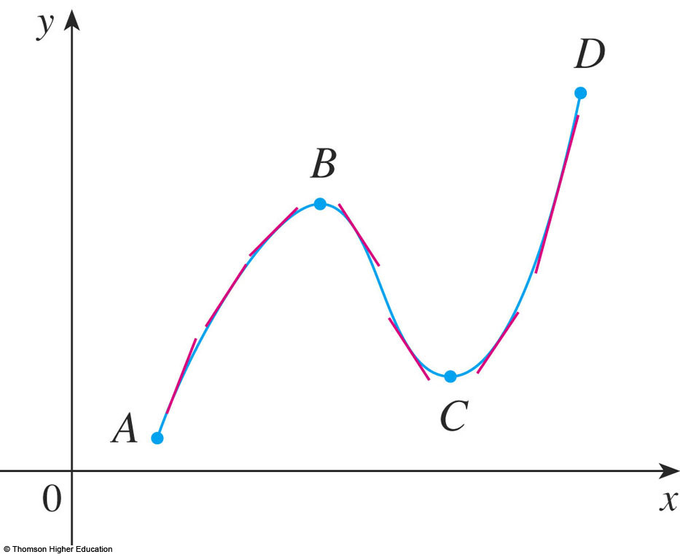
INCREASING/DECREASING TEST (I/D TEST)
If f’(x) > 0 on an interval, then f is increasing
on that interval.
If f’(x) < 0 on an interval, then f is decreasing on that interval.

Slide 62
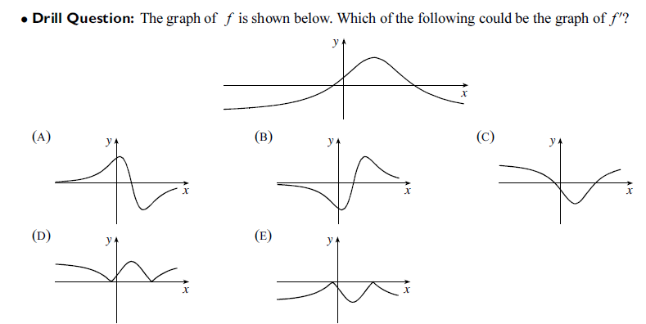
Notes:
If f(x) > 0 every x in I, the graph of its lies above x-axis.

Slide 63
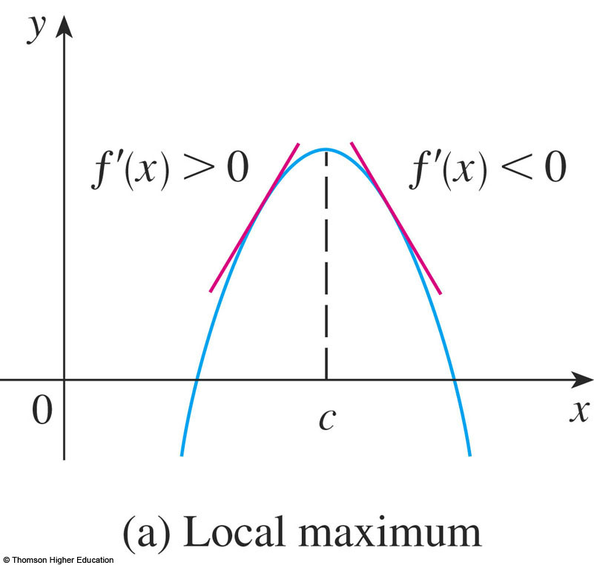
FIRST DERIVATIVE TEST
Suppose that c is a critical number of a continuous function f.
If f’ changes from positive to negative at c, then f has a local maximum at c.
Notes:
For example y = -x²

Slide 64
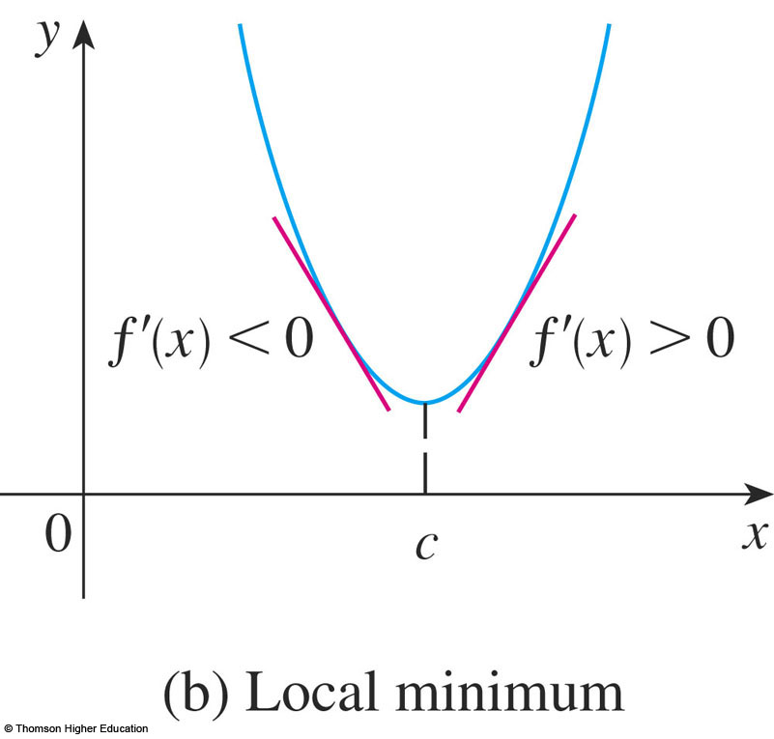
FIRST DERIVATIVE TEST
b. If f’ changes from negative to positive at c, then f has a local minimum at c.
Notes:
For example y=x²

Slide 65
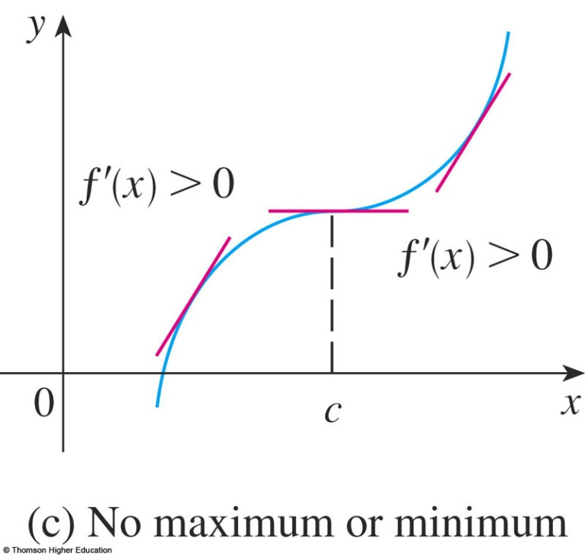

FIRST DERIVATIVE TEST
c. If f’ does not change sign at c
then f has no local maximum or minimum at c.
Notes:
For example y=x³ ; y = -x³

Slide 66


CONCAVE UPWARD/DOWNDWARD
  The curve lies above the tangents and f is called concave upward (lõm lên) on (a, b).
  The curve lies below the tangents and g is called concave downward (lõm xuống) on (a, b).

Slide 67

CONCAVITY TEST
If f’’(x) > 0 for all x in I, then the graph of f is concave upward on I.
If f’’(x) < 0 for all x in I, then the graph of f is concave downward on I.

Slide 68
INFLECTION POINT—DEFINITION
A point P on a curve y = f(x) is called an inflection point (điểm uốn)
if f is continuous there and the curve changes
from concave upward to concave downward
(or from concave downward to concave upward at P).
Notes:
f’’(x) =0 does not imply that (x,f(x)) is an inflection point of f.
f’’ changes from positive to negative or f’’ changes from negative to positive at a value that f’’ = 0.

Slide 69


Slide 70

SECOND DERIVATIVE TEST
Suppose f’’ is continuous near c.
If f’(c) = 0 and f’’(c) > 0,
then f has a local minimum at c.
If f’(c) = 0 and f’’(c) < 0,
then f has a local maximum at c.
Notes:
Compare the First and second derivative Tests, discussing the advantages and disadvantages of using each, including an example such as f(x) = x⁵ , where the second derivative test is inconclusive and pointing out that although f’(0) = 0,, there is no local extreme there.

Slide 71
Choose the correct one.
A | If f has local extreme value at c then f’(c)=0.
B | If f’(c)=0 then f has local extreme value at c.
C | If f’’(3)=0 then (3,f(3)) is an inflection point of f.
D | There exists a function such that f’(x) is nonzero for all x and f(1)=f(0).
E | None of the above

Slide 72
APPLICATIONS OF DIFFERENTIATION
4.6
Limit at Infinity and Assymtotes
Notes:
The method given in the text for setting up and solving optimization problems.
The various tests and closed interval method for finding absolute extreme.
Various useful techniques for simplifying computations during optimization problems, such as implicit differentiation and optimizing d² instead of the distance d to avoid the square root.

Slide 73

Limits at Infinity and Assymtotes

Slide 74

Limits at Infinity and Assymtotes
Example: Find the asymptotes of the function

Slide 75
APPLICATIONS OF DIFFERENTIATION
4.7
Applied Optimization Problems
In this section, we will learn:
How to solve problems involving
maximization and minimization of factors.
Notes:
The method given in the text for setting up and solving optimization problems.
The various tests and closed interval method for finding absolute extreme.
Various useful techniques for simplifying computations during optimization problems, such as implicit differentiation and optimizing d² instead of the distance d to avoid the square root.

Slide 76
1. UNDERSTAND THE PROBLEM
Read the problem carefully until it is clearly understood.
  What is the unknown?
  What are the given quantities?
  What are the given conditions?

Slide 77
2. FIND THE ABSOLUTE MAX./MIN. VALUE OF f
Use the methods of Sections 4.3 to find the absolute maximum or minimum value of f.
  In particular, if the domain of f is a closed interval,
  then the Closed Interval Method in Section 4.1
  can be used.

Slide 78
Find two positive numbers such that the sum is 24
and the product is the largest?
Find two positive numbers such that the product is 36
and the sum is the smallest?

Slide 79
APPLIED OPTIMIZATION PROBLEMS
Find the point on the line y = 2x -3
that is closest to the origin.
Example 1

Slide 80
Example 1
(x,2x-3) is in the line and the distance from it to the origin is …
We find the minimum of…

Slide 81

APPLIED OPTIMIZATION PROBLEMS
Example 2
A farmer has 2400 ft of fencing and wants to fence off a rectangular field that borders a straight river. He needs no fence along the river.
  What are the dimensions of the field that has the largest area ?

Slide 82
APPLIED OPTIMIZATION PROBLEMS
Example
This figure illustrates
the general case.
We wish to maximize the area A of the rectangle.
  Then, we express A in terms of x and y: A = xy
  2x + y = 2400
  So, A(x) = 2400x – 2x², 0 ≤ x ≤ 1200
  …

Slide 83

APPLIED OPTIMIZATION PROBLEMS
Example
A man launches his boat from point A on a bank of a straight river, 3 km wide, and wants to reach point B (8 km downstream on the opposite bank) as quickly as possible.
If he can row 6 km/h and run 8 km/h, where should he land to reach B as soon as possible?
Notes:
S=vt

Slide 84




APPLIED OPTIMIZATION PROBLEMS
Example
We use the equation:
  Then, the rowing time is:
  The running time is: (8 – x)/8
  So, the total time T as a function of x is:

Slide 85
A rectangular storage container with an open top is to have a volume of 15 m³ The length of its base is twice the width.
Material for the base costs $10 per square meter. Material for the sides costs $6 per square meter. Find the cost of materials for the cheapest such container.

Slide 86
APPLICATIONS OF DIFFERENTIATION
4.9
Newton’s Method
In this section, we will learn:
How to solve high-degree equations
using Newton’s method.
Notes:
Newton’s method and its uses.
Geometric interpretation of Newton’s method.
The speed of approximation of Newton’s method.

Slide 87
NUMERICAL ROOTFINDERS
How do those numerical root finders work?
  They use a variety of methods.
  Most, though, make some use of Newton’s method, also called the Newton-Raphson method.

Slide 88

NEWTON’S METHOD
We start with a first approximation x_{1,} which is obtained by one of the following methods:
  Guessing
  A rough sketch
  of the graph of f
  A computer-
  generated graph of f
Notes:
How do you do know what to choose as x₁ ?

Slide 89
NEWTON’S METHOD
Consider the tangent line L to the curve y = f(x) at the point (x₁, f(x₁)) and look at the x-intercept of L, labeled x₂.

Slide 90

SECOND APPROXIMATION
As the x-intercept of L is x₂, we set y = 0 and obtain:
0 - f(x₁) = f’(x₁)(x₂ - x₁)
If f’(x₁) ≠ 0, we can solve this equation for x₂:
  We use x₂ as a second approximation to r.

Slide 91


SUBSEQUENT APPROXIMATION
In general, if the nth approximation is x_{n} and
f’(x_{n}) ≠ 0, then the next approximation is given by:

Slide 92


CONVERGENCE
If the numbers x_{n} become closer and closer to r as n becomes large, then we say that the sequence converges to r and we write:

Slide 93


NEWTON’S METHOD
Example
Use Newton’s method to find correct to eight decimal places.
  First, we observe that finding is equivalent to
  finding the positive root of the equation x⁶ – 2 = 0
  So, we take f(x) = x⁶ – 2
  Then, f’(x) = 6x⁵

Slide 94

NEWTON’S METHOD
Example
So, Formula 2 (Newton’s method) becomes:

Slide 95


NEWTON’S METHOD
Example
Choosing x₁ = 1 as the initial approximation, we obtain:
  As x₅ and x₆ agree to eight decimal places, we
  conclude that to eight decimal places.

Slide 96


Slide 97
APPLICATIONS OF DIFFERENTIATION
4.10
Antiderivatives
In this section, we will learn about:
Antiderivatives and how they are useful
in solving certain scientific problems.
Notes:
Anti derivatives with and without initial conditions.
Position, velocity and acceleration.

Slide 98
DEFINITION
A function F is called an antiderivative of f on an interval I if F’(x) = f(x) for all x in I.

Slide 99
ANTIDERIVATIVES
Theorem
If F is an antiderivative of f on an interval I,
the most general antiderivative of f on I is
F(x) + C
where C is an arbitrary constant.

Slide 100
Let f(x)=tanx, and F(x) is an antiderivative of f(x). Evaluate f
and tell whether F is increasing or decreasing at x= - 3 (rad)
Answer:

Slide 101

ANTIDERIVATIVE FORMULA
Here, we list some particular antiderivatives.

Slide 102
RECTILINEAR MOTION
Example
A particle moves in a straight line and has acceleration given by a(t) = 6t + 4.
Its initial velocity is v(0) = -6 cm/s and its initial displacement is s(0) = 9 cm.
  Find its position function s(t).

Slide 103
A particle moves along the x-axis so that its velocity at time t is given by 3 sin 2t.
Assuming it starts at the origin, where is it at t = π seconds?
a. 0 b. 3/2 c. ½ d. - 1/2

Slide 104
Let f(x)=4-3x for all x>=2. Select the correct one.
2 is the local minimum value.
2 is the local maximum value.
-2 is the local minimum value.
-2 is the maximum local value.
2 is the absolute minimum value.
-2 is the absolute maximum value.
None of the above.
Answer: f

Slide 105
A piece of wire (dây kim loại) 10 m long is cut into two pieces. One piece is bent into a square and the other is bent into an equilateral triangle (tam giác đều).
How should the wire be cut for the square so that the total area (of the square and the triangle) enclosed is a minimum? Round the result to the nearest hundredth.
Answer: If x is the length of the square then
the side of the triangle is 1/3 (10-4x)
We find the minimum of x²+…

Slide 106
Thanks

